Slide 1
Consumption
Lecture 5
Mentor: Pham Xuan Truong
(truongpx@ftu.edu.vn)

Slide 2
Content
I John Maynard Keynes and the consumption function
II Irving Fisher and Inter-temporal choice
III Franco Modigliani and the life – cycle hypothesis
IV Milton Friedman and the Permanent – Income Hypothesis
V Other modern consumption models

Slide 3
I John Maynard Keynes and the consumption function
The consumption function was central to Keynes’ theory of economic fluctuations presented in The General Theory in 1936.
+ Keynes conjectured that the marginal propensity to consume— the amount consumed out of an additional dollar of income is between zero and one. He claimed that the fundamental law is that out of every dollar of earned income, people will consume part of it and save the rest.
+ Keynes also proposed the average propensity to consume, the ratio of consumption to income falls as income rises.
+ Keynes also held that income is the primary determinant of consumption and that the interest rate does not have an important role.

Slide 4
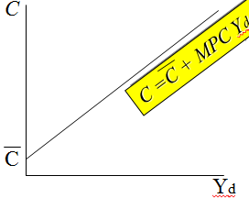
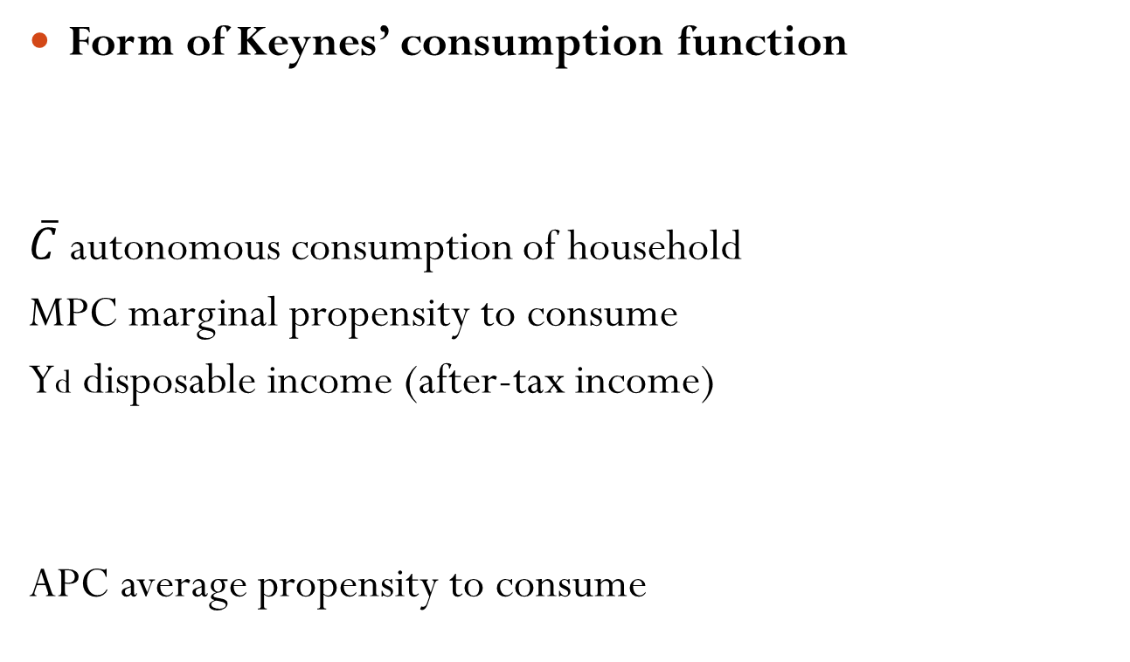
I John Maynard Keynes and the consumption function
Form of Keynes’ consumption function
$\overline{C}$ autonomous consumption of household
MPC marginal propensity to consume
Yd disposable income (after-tax income)
APC average propensity to consume

Slide 5
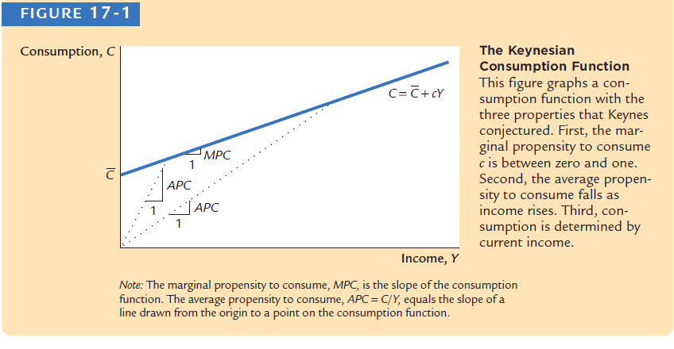
I John Maynard Keynes and the consumption function
This consumption function exhibits three properties that Keynes conjectured
+ First, the marginal propensity to consume c is between zero and one.
+ Second, the average propensity to consume falls as income rises
+ Third, consumption is determined by current income Y.

Slide 6
I John Maynard Keynes and the consumption function
Simon Kuznets and secular stagnation
During World War II, on the basis of Keynes’s consumption function, economists predicted that the economy would experience what they called secular stagnation—a long depression of infinite duration caused by insufficient investment compared with massive saving when income increases— unless the government used fiscal policy to stimulate aggregate demand. It turned out that the end of the war did not throw the United States into another depression, but it did suggest that Keynes’s conjecture that the average propensity to consume would fall as income rose appeared not to hold.
Simon Kuznets constructed new aggregate data on consumption and investment dating back to 1869. His work would later earn him a Nobel Prize. Kuznets discovered that the ratio of consumption to income was stable over time, despite large increases in income; again, Keynes’s conjecture was called into question.
This brings us to the puzzle…

Slide 7
I John Maynard Keynes and the consumption function
Data of household consumption in short-run supports Keynes’s idea about decreasing APC
Data of household consumption in long – run supports Kuznets finding about constant APC
C
Long-run consumption function (constant APC)
Short-run
consumption
function
(falling APC)
Y

Slide 8
II Irving Fisher and Inter-temporal choice
The economist Irving Fisher developed the model with which economists analyze how rational, forward-looking consumers make intertemporal choices—that is, choices involving different periods of time.
The model illuminates the constraints consumers face, the preferences they have, and how these constraints and preferences together determine their choices about consumption and saving

Slide 9
II Irving Fisher and Inter-temporal choice
Building intertemporal budget constraint line
- When consumers are deciding how much to consume today versus how much to consume in the future, they face an intertemporal budget constraint, which measures the total resources available for consumption today and in the future
- Assume that a person lives in two – period life (e.g. young and old). He will consume all income in the second period
+ Income and consumption in the first period: Y₁, C₁
Income and consumption in the second period: Y₂,C₂
+ Saving in the first period S₁ = Y₁ – C₁ Because all income will be consumed in the second period so
C₂ = S₁(1+r) + Y₂ = (Y₁-C₁)(1+r)+Y₂
or

Slide 10
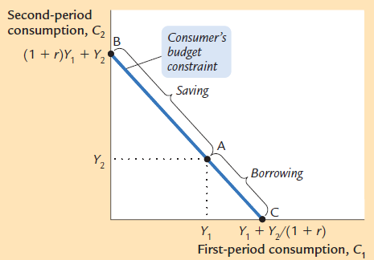
II Irving Fisher and Inter-temporal choice
Building intertemporal budget constraint line
Downward slope with
coefficient of 1 + r
Intersection with vertical
axis and horizontal axis
A point exhibits saving of
the first period is 0; above is
saving – below is borrowing

Slide 11
II Irving Fisher and Inter-temporal choice
Building consumer conference indifference curve
The consumer’s preferences regarding consumption in the two periods can be represented by indifference curves. An indifference curve shows the combination of first-period and second-period consumption that makes the consumer equally happy. The slope at any point on the indifference curve shows how much second-period consumption the consumer requires in order to be compensated for a 1-unit reduction in first-period consumption. This slope is the marginal rate of substitution between first-period consumption and second-period consumption. It tells us the rate at which the consumer is willing to substitute second-period consumption for first-period consumption.

Slide 12
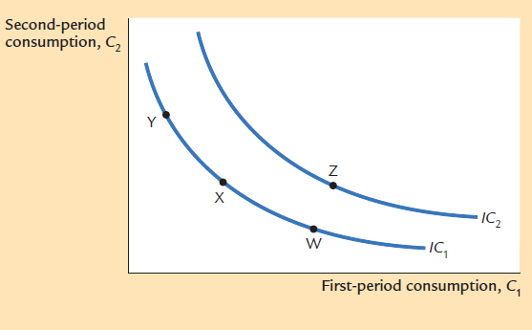
II Irving Fisher and Inter-temporal choice
Building consumer conference indifference curve
Downward sloping
No intersection between two
different indifferent curves
Outside indifferent curves
satisfies consumer more inside
one

Slide 13
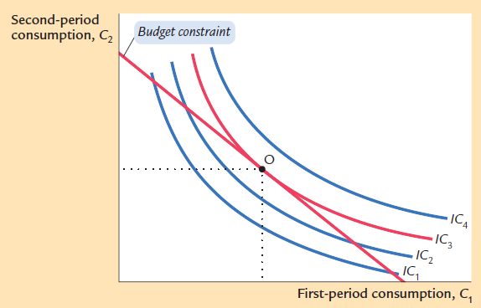
II Irving Fisher and Inter-temporal choice
Consumption optimization
Consumer optimize his benefit as deciding consume at point O, which is the contact point between the highest indifferent curve that makes contact with budget constraint line

Slide 14
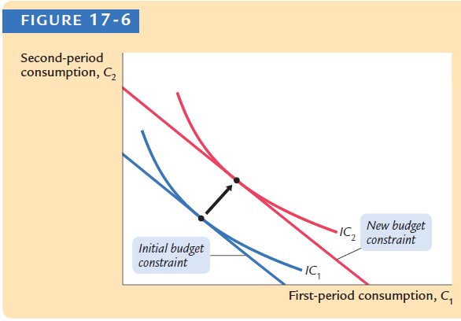
II Irving Fisher and Inter-temporal choice
Effect on consumption decision as income changes

Slide 15
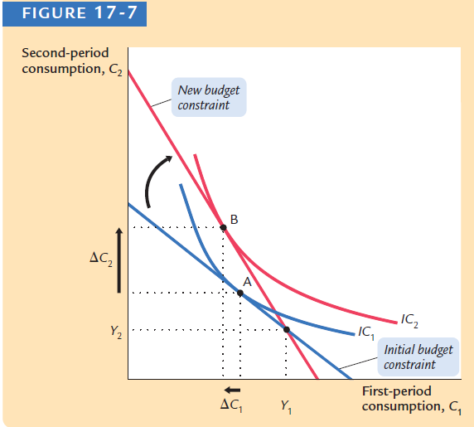
II Irving Fisher and Inter-temporal choice
Effect on consumption decision as interest rate changes

Slide 16
II Irving Fisher and Inter-temporal choice
Effect on consumption decision as interest rate changes
+ Income effect: the change in consumption that results from the movement to a higher indifference curve
+ Substitution effect: the change in consumption that results from the change in the relative price of consumption in the two periods
 |  | C₁ | C₂
S₁ > 0 | r increases | ambiguous | increase
 | r decreases | ambiguous | decrease
S₁ < 0 | r increases | decrease | ambiguous
 | r decreases | increase | ambiguous

Slide 17
III Franco Modigliani and the life – cycle hypothesis
In the 1950s, Franco Modigliani, Ando, and Brumberg used Fisher’s model of consumer behavior to study the consumption function. One of their goals was to study the consumption puzzle. According to Fisher’s model, consumption depends on a person’s lifetime income. Modigliani emphasized that income varies systematically over people’s lives and that saving allows consumers to move income from those times in life when income is high to those times when income is low. This interpretation of consumer behavior formed the basis of his life-cycle hypothesis.

Slide 18
III Franco Modigliani and the life – cycle hypothesis
Assume that a person will live more T years and works more R years. He owns wealth that values W and expect annual income Y until retirement. To smooth consumption over the rest of his life, which type of consumption pattern he will decide
According to Life-cycle Hypothesis
C = (W + RY)/T or C = (1/T) W + (R/T)Y
E.g. T = 50, R = 30 → C = 0.02W + 0.6Y
In general form we have C = αW + βY in which, α measures MPC regarding wealth and β measures MPC regarding income

Slide 19
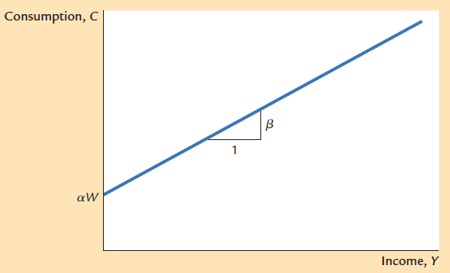
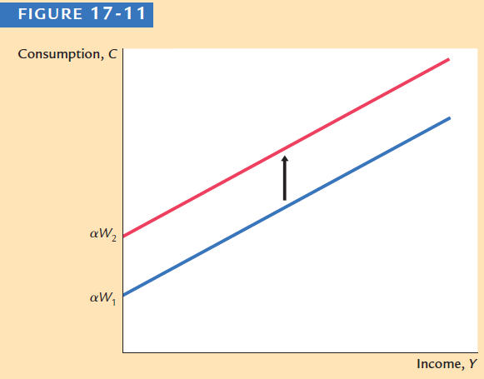
III Franco Modigliani and the life – cycle hypothesis
Life – cycle hypothesis explains why APC is constant in the long – run
APC = C /Y = (αW + βY)/Y = αW/Y + β

Slide 20
IV Milton Friedman and the Permanent – Income Hypothesis
In 1957, Milton Friedman proposed the permanent-income hypothesis to explain consumer behavior. Its essence is that current consumption is proportional to permanent income. Friedman’s permanent-income hypothesis complements Modigliani’s life-cycle hypothesis: both use Fisher’s theory of the consumer to argue that consumption should not depend on current income alone. But unlike the life-cycle hypothesis, which emphasizes that income follows a regular pattern over a person’s lifetime, the permanent-income hypothesis emphasizes that people experience random and temporary changes in their incomes from year to year.
Friedman suggested that we view current income Y as the sum of two components, permanent income Y^{P} and transitory income Y^{T}
Y = Y^{P}+Y^{T}

Slide 21
IV Milton Friedman and the Permanent – Income Hypothesis
permanent income could be attributed to average income; transitory income could be attributed to error between actual income and average income
Milton Friedman concluded that we can approximately formulate consumption function as C = αY^{P} in which α is coefficient measuring proportion of Y^{P} used for consumption. Individuals will recourse to saving or borrowing to smooth their consumption when Y^{T} changes; meaning that changes of Y^{T} only alter saving (apply to government policy that reduces tax)

Slide 22
IV Milton Friedman and the Permanent – Income Hypothesis
APC = C/Y = αY^{P}/Y=αY^{P}/(Y^{P+}Y^{T})
+ short-run: changes in income frequently come from Y^{T} therefore APC decreases when Y increases
+ long-run: changes in income usually come from Y^{P} therefore APC slightly constant when Y increases

Slide 23
V Other modern consumption models
Robert Hall and random walk hypothesis
Robert Hall was first to derive the implications of rational expectations for consumption. He showed that if the permanent income hypothesis is correct, and if consumers have rational expectations, then changes in consumption over time should be unpredictable. When changes in a variable are unpredictable, the variable is said to follow a random walk.
According to Hall, the combination of the permanent-income hypothesis and rational expectations implies that consumption follows a random walk.

Slide 24
V Other modern consumption models
David Laibson and pull of instant gratification
Recently, economists have turned to psychology for further explanations of consumer behavior. They have suggested that consumption decisions are not made completely rationally. This new subfield infusing psychology into economics is called behavior economics. Harvard’s David Laibson notes that many consumers judge themselves to be Imperfect decision makers. Consumers’ preferences may be time- inconsistent: they may alter their decisions simply because time passes.

